Slide 1
ANGULAR
Introduction with code along

Slide 2
Intro
Intro to ES6 and Typescript
Angular development ecosystem (VS Code, ALS and NPM)
Anatomy of an Angular App (Decorators, DI and Components)
Template, Internal Directives and Binding
Routing and Server communication
Build and Release.

Slide 3
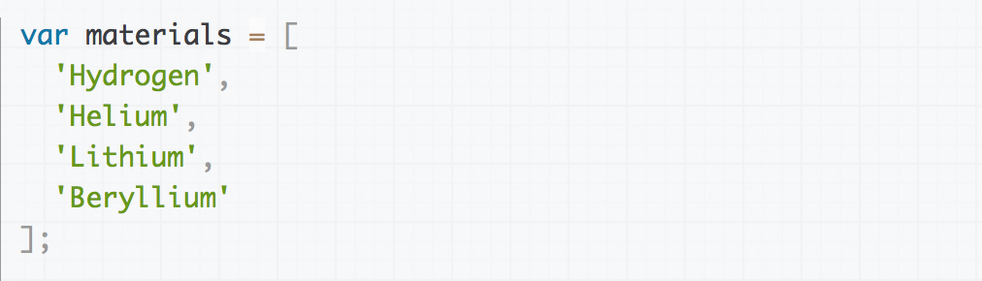
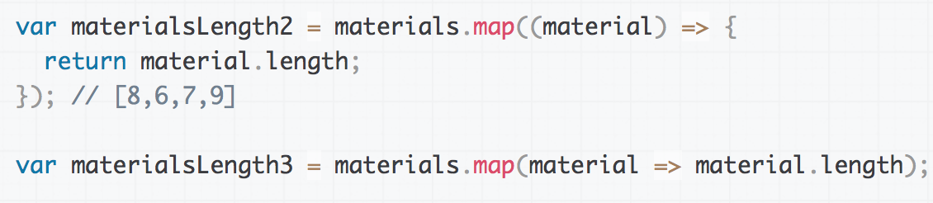
ES 6 Features (Ecmascript 2015)
Block Scopes
Template Strings
Classes
Default Params
Destructuring
Arrow Functions
Modules

Slide 4
TypeScript
Type Inference and Data Types
Interfaces
Classes and Access Modifiers
Static and Instance Members
Function Overloading
Generics
Decorators
TypeScript is a free and open-source programming language developed and maintained by Microsoft.
It is a strict superset of JavaScript, and adds optional static typing and class-based object-oriented programming to the language.
Angular is written in Typescript

Slide 5




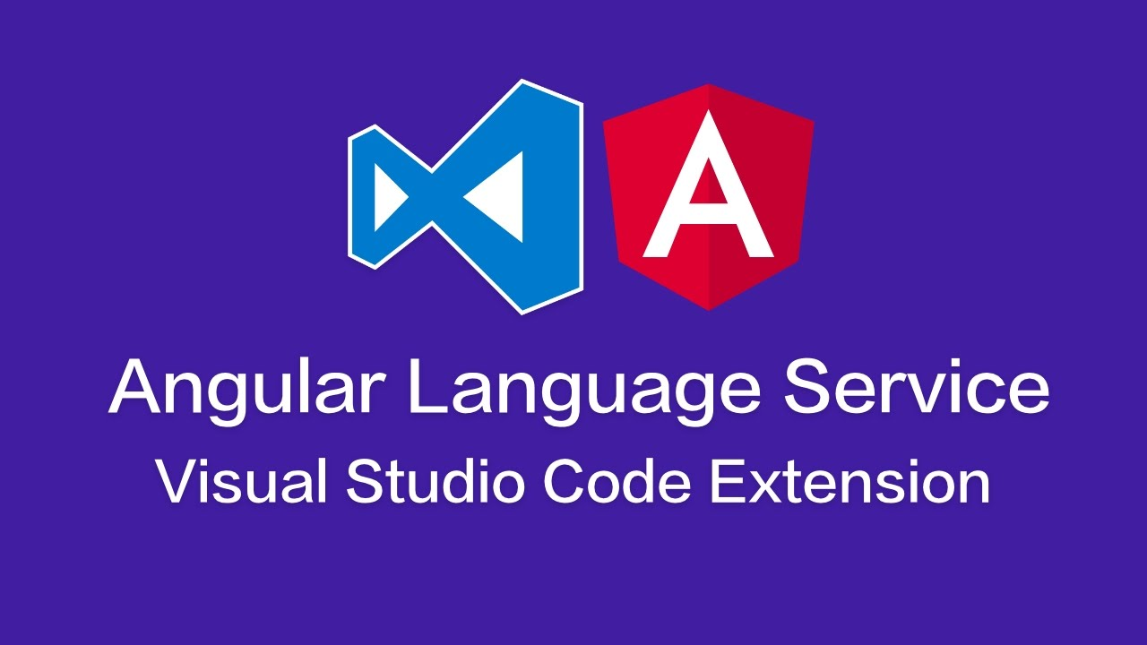
Development Ecosystem
Must have: Git, Node and Typescript Compiler
Editors: VS Code, Atom, Sublime,
WebStorm, Eclipse etc.

Slide 6
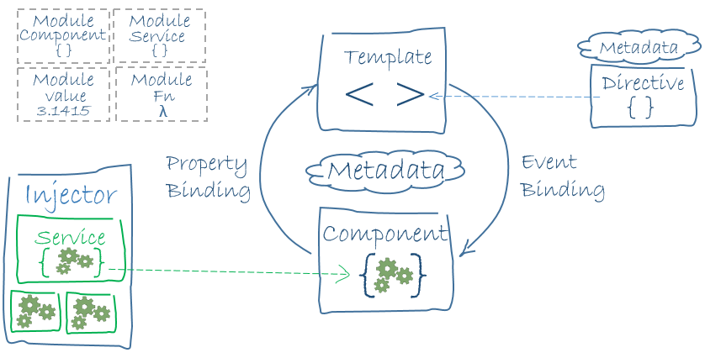
Anatomy of an Angular application

Slide 7
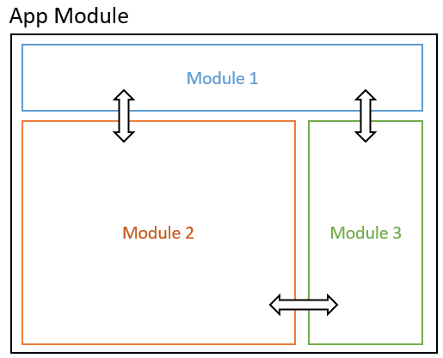
Modules
Top most logical container
Provides selective export
Can be lazy loaded
Contains:
Components
Services
Routes
Pipes
Directives etc

Slide 8
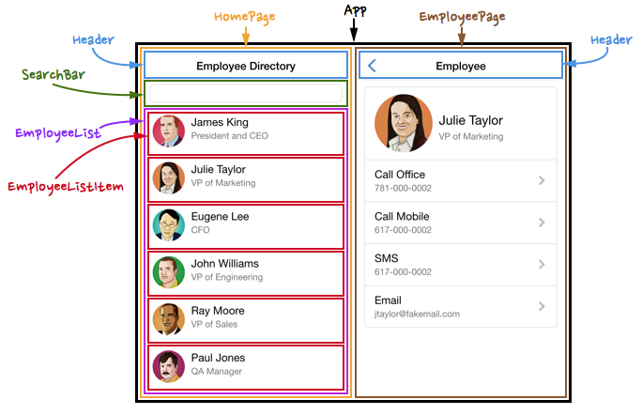
Sample Contacts App

Slide 9
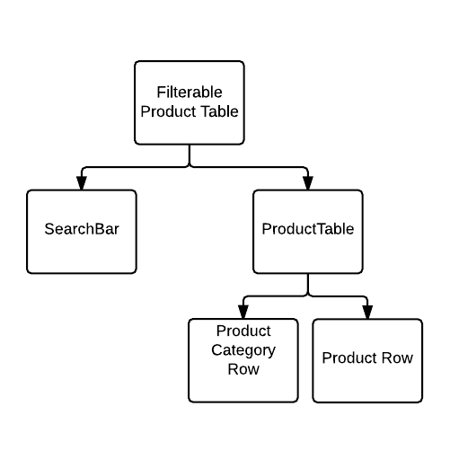
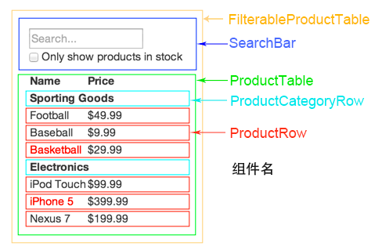
UI Component Hierarchy

Slide 10
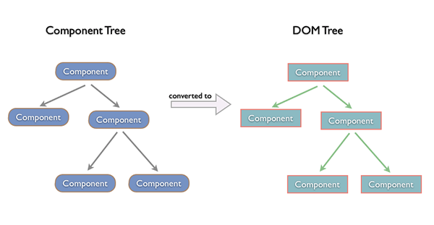
Eventual DOM Tree

Slide 11
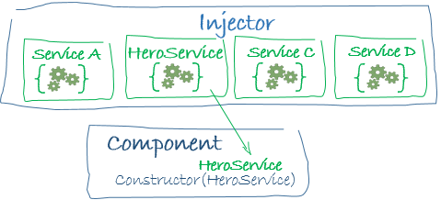
Decorators & Dependency Injection
import { NgModule } from '@angular/core'; import { BrowserModule } from '@angular/platform-browser'; @NgModule({ imports: [ BrowserModule ], providers: [ Logger ], declarations: [ AppComponent ], exports: [ AppComponent ], bootstrap: [ AppComponent ] }) export class AppModule { }
constructor(private service: HeroService) { }

Slide 12
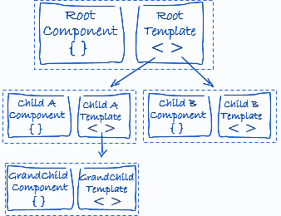
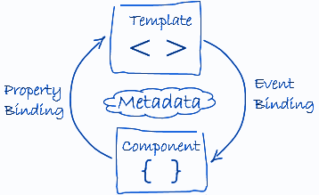
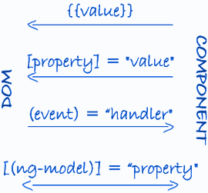
Components,
Templates &
Binding
@Component({ selector: 'app-root', templateUrl:'./app.component.html', styleUrls: ['./app.component.sass'] })
------------------------------------

Slide 13
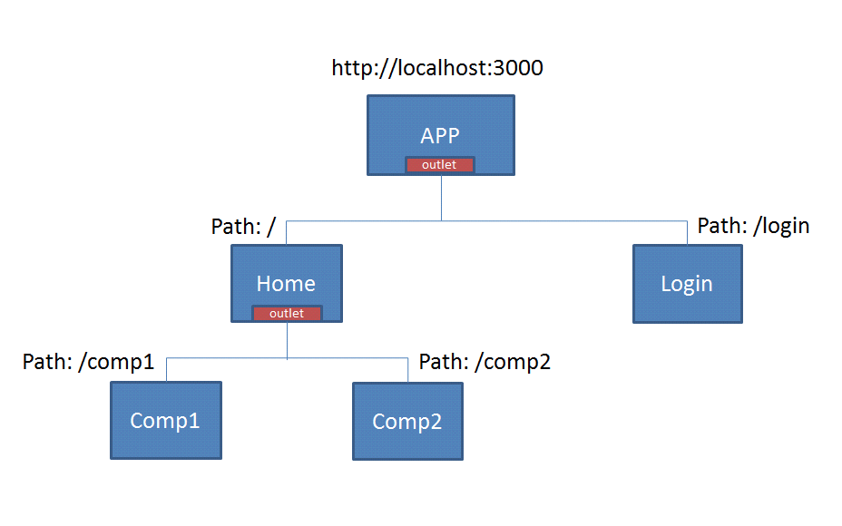
Routing
The Angular Router enables navigation from one view to the next as users perform application tasks.
It can interpret a browser URL as an instruction to navigate to a client-generated view.

Slide 14
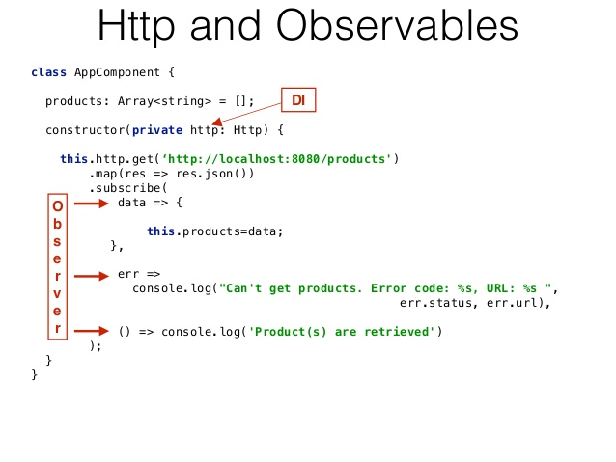
Server Communication
Performs http requests using “XMLHttpRequest” as default backend
Http is available as an Injectable class
Calling a request returns an Observable which will emit a single Response when a response is received.

Slide 15

Build and Release
Ahead-of-Time (AOT) Compilation: pre-compiles Angular component templates.
Bundling: concatenates modules into a single file (bundle).
Inlining: pulls template html and css into the components.
Minification: removes excess whitespace, comments, and optional tokens.
Uglification: rewrites code to use short, cryptic variable and function names.
Dead code elimination: removes unreferenced modules and unused code.
Pruned libraries: drop unused libraries and pare others down to the features you need.
Performance measurement: focus on optimizations that make a measurable difference.

Slide 16
Thank you.

